Slide 1
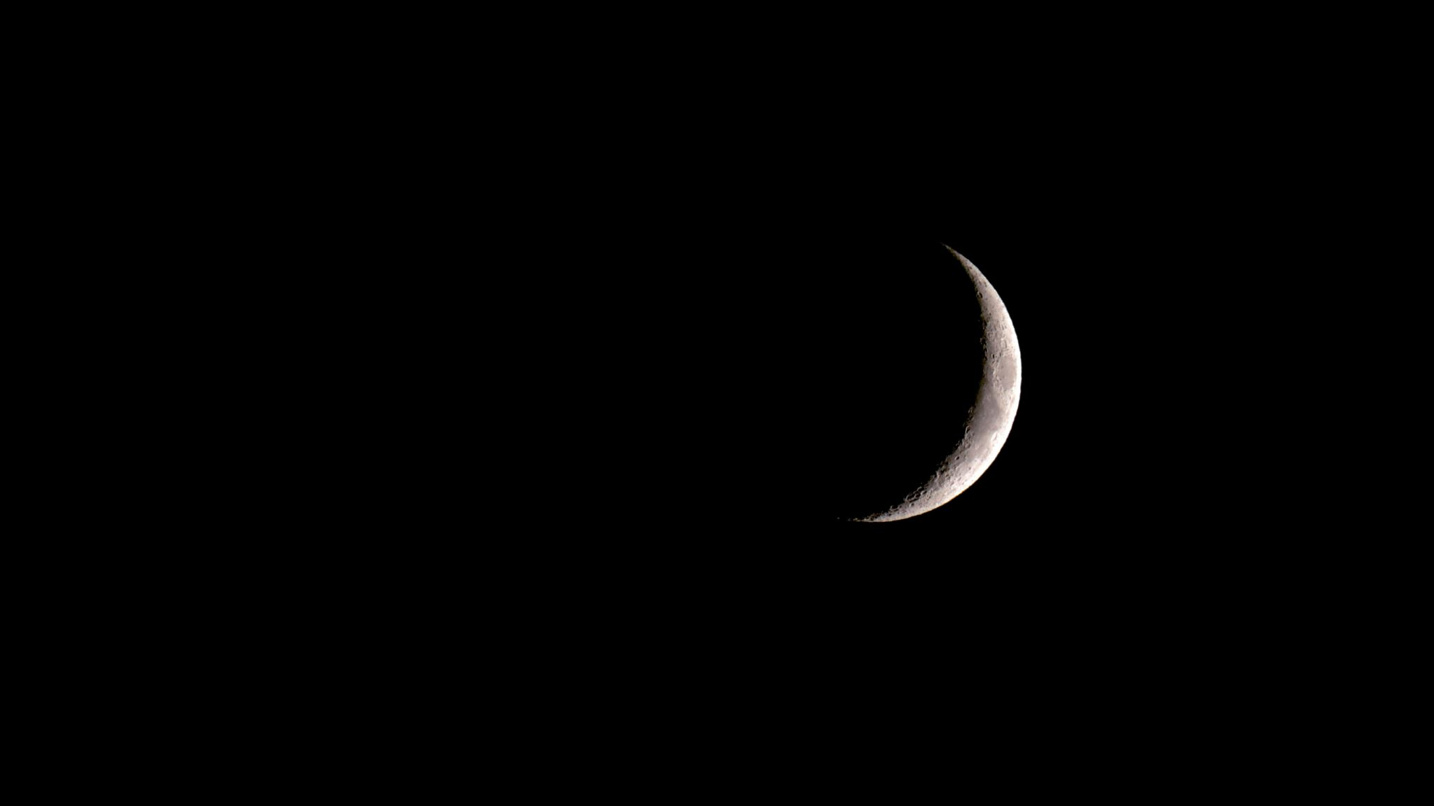
On a Dark and Scary Night
Choose Your Own Adventure Song

Slide 2
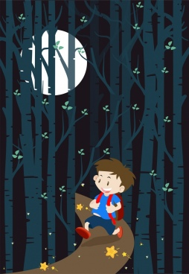
On a Dark and Scary night…
I was home watching TV I went for a walk in the woods

Slide 3
I heard a crash close by. I heard a knock on the door.

Slide 4
I heard a crash close by. I heard a whisper close by.
Whisper…

Slide 5
I went to investigate. I got scared and started to shake

Slide 6
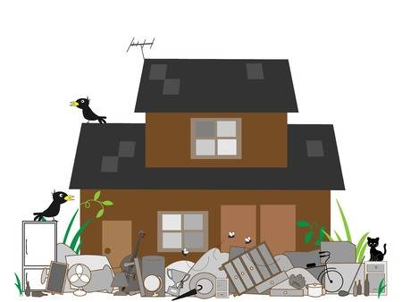
I saw a mess nearby. I saw a shadow hiding nearby

Slide 7
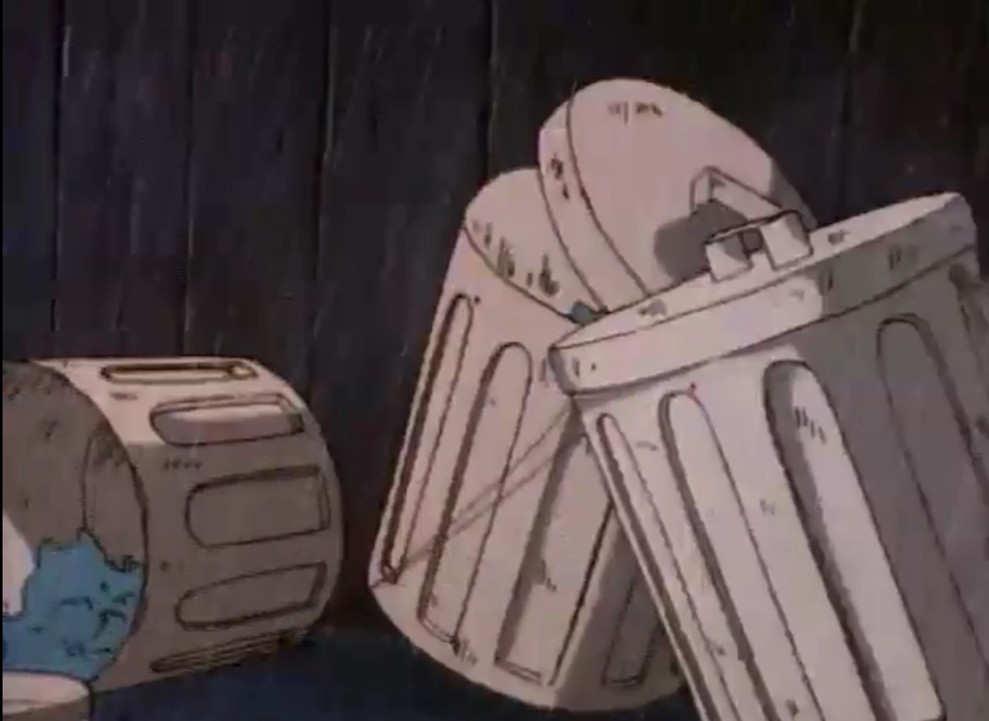
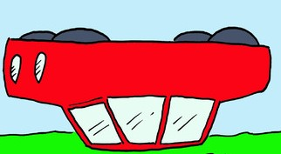
There was garbage all There was a car turned over the place. upside down.

Slide 8
I cleaned it up and went to bed. I ran back into the house.

Slide 9
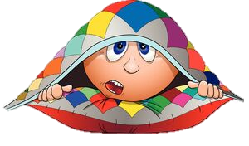
I heard a knock on the door. I hid under a blanket.

Slide 10
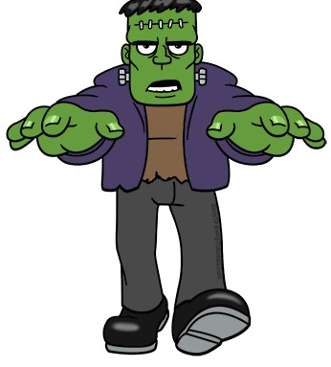
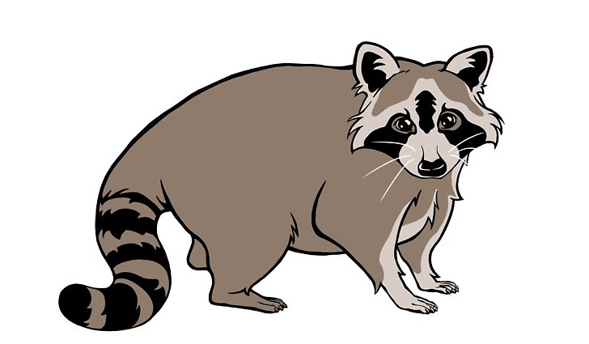
It was small and furry. It was tall and scary.

Slide 11
The creature started to The creature started to growl at me. smile at me.

Slide 12
The creature started to The creature started to growl at me. smile at me.

Slide 13
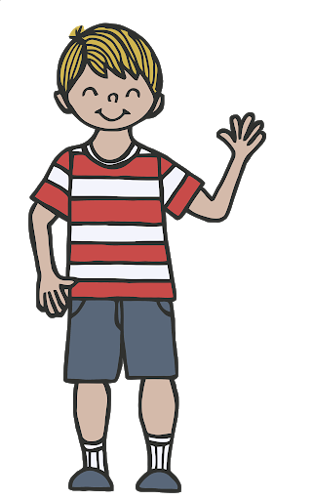
I took a picture of I waved “Hi” the creature. to the creature.

Slide 14
I screamed when I saw it! I ran away as fast as I could.

Slide 15
I screamed when I saw it! I ran away as fast as I could.

Slide 16
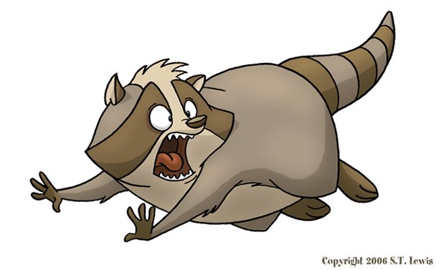
That creature started That creature started to wave at me. to chase me.

Slide 17
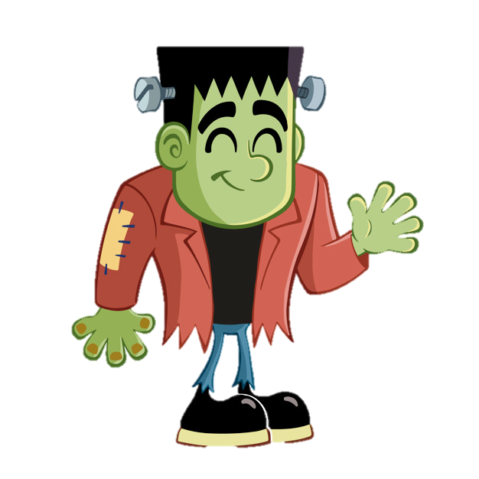
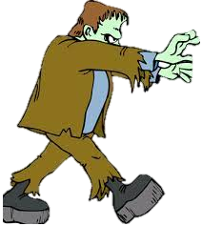
That creature started That creature started to wave at me. to chase me.

Slide 18
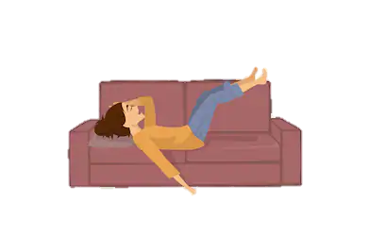
I ran home and was safe. I hid in the bushes.

Slide 19
The creature ran right by. He found me and chased me some more.
We’re Safe!

Slide 20
The creature ran right by. He found me and chased me some more.
We’re Safe!

Slide 21
I got away and ran back home. He caught me and ate me for dinner.

Slide 22
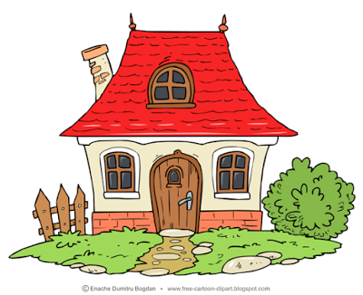
I got away and ran back home. He caught me and ate me for dinner.

Slide 23
I decided to take a peek I yelled, “Who is it?”

Slide 24
I heard a louder I heard a whisper close by. knock this time.
Whisper…

Slide 25
I got scared and I yelled, “Who is it?” started to shake.

Slide 26
I heard a purr nearby. I heard a growl nearby.
purrr

Slide 27
I went to investigate. I decided to run away.

Slide 28
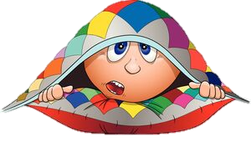
I went to investigate. I hid under a blanket.

Slide 29
I decided to take a peek. I heard whisper outside.
Whisper…

Slide 30
On a Dark and Scary Night!!!

